Slide 1
IF,IFELSE AND NESTED IF IN C
PREPARED BY:NIDA WAHEED

Slide 2
IF STATEMENT
IF STATEMENT
It takes an expression in parenthesis and an statement or block of statements.
if the expression is true then the statement or block of statements gets executed otherwise these statements are skipped.

Slide 3
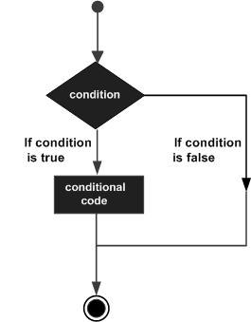
IF STATEMENT
SYNTAX OF IF STATEMENT:
if (expression)
statement;
if ( statement is TRUE )
Execute this line of code

Slide 4
IF STATEMENT
#include<stdio.h>
int main()
{
int a= 10;
/*check the following condition*/
if(a<20)
{
/*if condition is true then print the following*/
printf("value of a is less than 20\n");
}
printf("value of a is =%d\n",a);
getch();
}

Slide 5
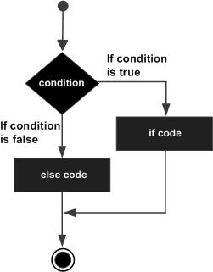
IF –ELSE STATEMENT
IF-ELSE STATEMENT:
Almost two option.
SYNTAX OF IF-ELSE STATEMENT:
If(condition)
{
True part;
}
Else{
False part;
}

Slide 6
IF-ELSE STATEMENT
#include <stdio.h>
int main ()
{
int a = 100;
/* check the condition */
if( a < 20 )
{
/* if condition is true then print the following */
printf("a is less than 20\n" );
}
else
{
/* if condition is false then print the following */
printf("a is not less than 20\n" );
}
printf("value of a is =%d\n", a);
getch();
}

Slide 7
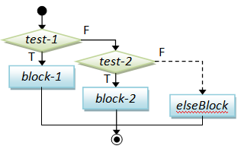
CONDITIONAL STATEMENT
NESTED IF STATEMENT:
In nested if control statement, if condition 1 is false, then condition 2 is checked and statements are executed if it is true.
If condition 2 also gets failure, then else part is executed.

Slide 8
NESTED IF
#include<stdio.h>
int main()
{
int a =100;
int b=200;
/*check the condition*/
if(a=100)
{
/*if condition is true then check the following*/
if(b=200)
/* if condition is true then print the following*/
{
printf("value of a is 100 and b is 200\n");
}
}
printf("exact value of a is =%d\n",a);
printf("exact value of b is =%d\n",b);
getch();
return 0;
}

